Slide 1


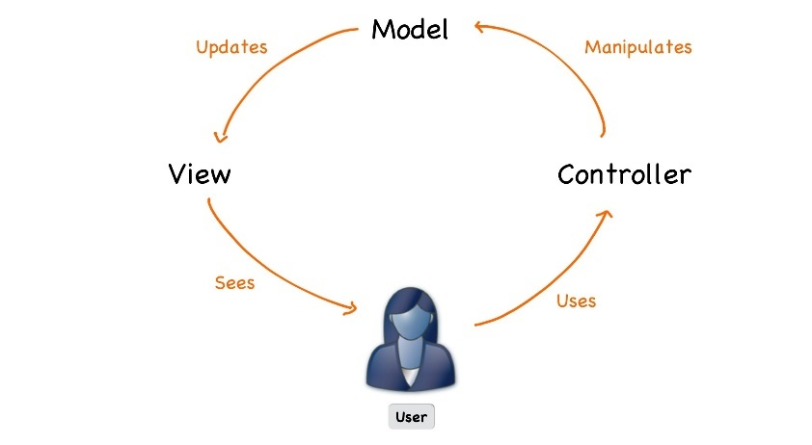




C#/Java Web Development Basics
Course Overview
Web Development Basics
SoftUni Team
Technical Trainers
Software University
http://softuni.bg

Slide 2



Table of Contents
Course Objectives
Course Program
Trainers Team
Exams and Evaluation
Learning Resources

Slide 3
Have a Question?
sli.do #WebIntro

Slide 4


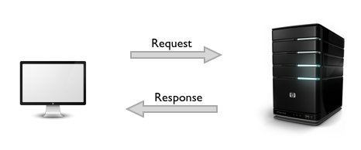

C#/Java Web Development Basics
Course Objectives & Program

Slide 5
Course Objectives
The C#/Java Web basics course provides
Basic knowledge over HTML and CSS
Fundamental knowledge over what is HTTP and how it works
Fundamental knowledge over what is a web server and what work it serves and how
Fundamental knowledge over the MVC pattern and it’s appliance in Web applications

Slide 6
Course Topics
Course opening: topics, schedule, trainers, exams, resources
Web servers, CGI Protocol, HTML basics
Request methods, Form submissions, Query Strings, HTML (links, forms)
Sessions, Cookies,
Persistence Layer introduction
Custom web server, State Management, Routing
MVC pattern, Hand-made Framework
Bootstrap, Web application with custom MVC deployed on the custom server

Slide 7
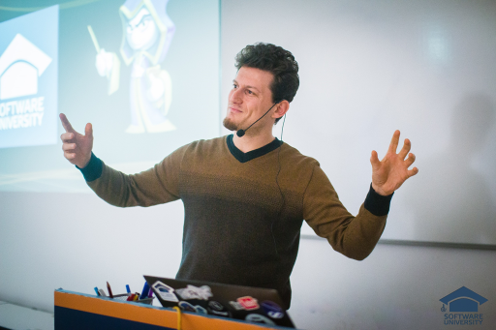
The Trainers Team

Slide 8
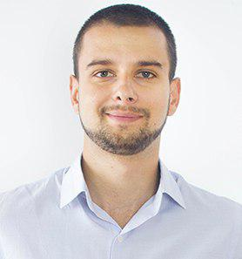
Trainers Team
Teodor Dimitrov
Technical Trainer @ Software University
Top performing student from the Software University
4 years of experience with SQL Server and Oracle
Background in telecommunication field

Slide 9
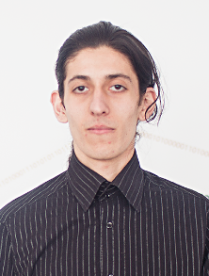
Trainers Team
Simeon Sheytanov
Technical Trainer @ Software University
Top performing student from the Software University
Programming experience with C#, Java, C++, Python, JavaScript, PHP, VB, Assembler and other programming languages
Interested in game development

Slide 10
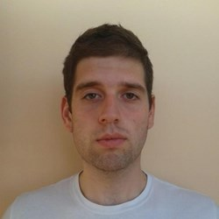
Trainers Team
Valentin Kolev
Technical Trainer @ Software University
Top performing student from the Software University
Experience in developing mobile apps

Slide 11
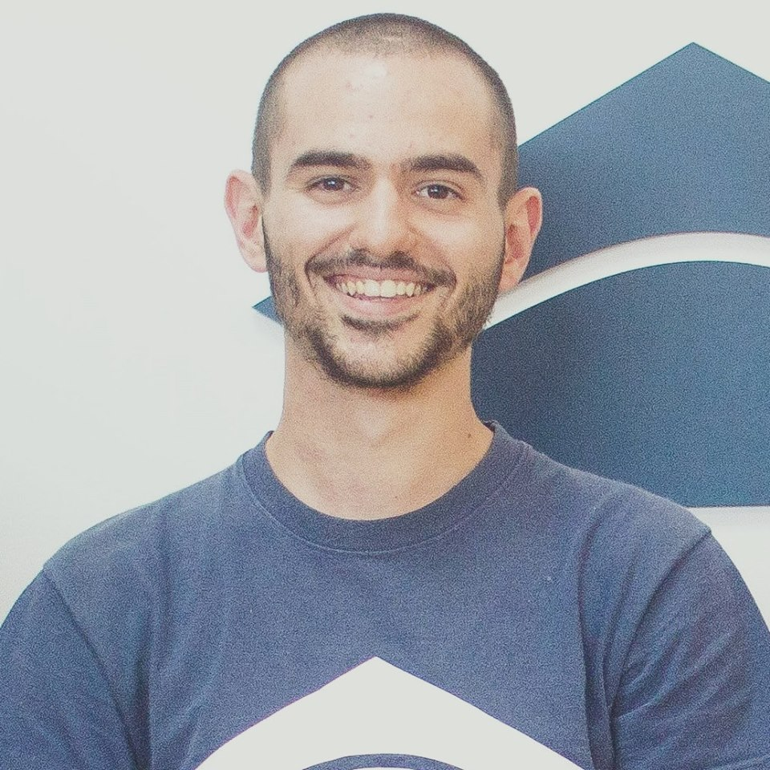
Trainers Team
Bozhidar Gevechanov
Technical Trainer @ Software University
Top performing student from the Software University
Experience in developing mobile games with Unity3D

Slide 12


Scoring System for the Course
Mandatory:
Final exam – 90%
Homework submissions – 10%
Bonuses:
Presence in class – 5% bonus
Forum activity – bonus up to 5%

Slide 13
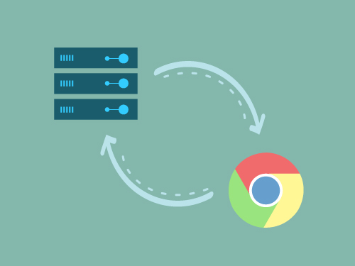
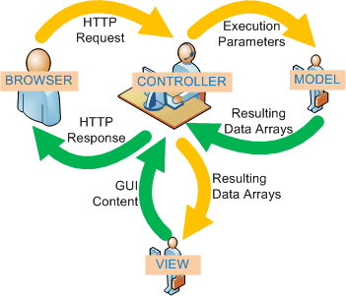
The Final Exam
Create a web application using the custom made web server with it’s implemented MVC architecture

Slide 14










Resources
What We Need Additionally?

Slide 15



Java Course Web Site, Forum and FB Group
Official web site:
Official discussion forum:
Official Facebook groups:
https://softuni.bg/trainings/1536/java-web-development-basics-january-2017
https://softuni.bg/forum/categories/73/java-web-development-basics
https://www.facebook.com/groups/javaweb2017/

Slide 16
C# Course Web Site, Forum and FB Group
Official web site:
Official discussion forum:
Official Facebook groups:
https://softuni.bg/trainings/1543/csharp-web-development-basics-january-2017
https://softuni.bg/forum/categories/66/csharp-web-development-basics
https://www.facebook.com/groups/csharpweb/

Slide 17

The Programming Basics Slides and Videos
All lecture slides, videos, homework assignments, projects and other resources are open content, available for free
Visit the course web site to access the course resources

Slide 18


C# Recommended Software
Software needed for this course:
Microsoft Windows 8.1 or 10
Visual Studio – https://www.visualstudio.com
MS SQL Server - https://www.microsoft.com/en-cy/sql-server/sql-server-downloads
Apache Server - http://www.wampserver.com/en/

Slide 19


Java Recommended Software
Software needed for this course:
IntelliJ Idea Ultimate - https://www.jetbrains.com/idea/
MySQL - https://www.apachefriends.org/index.html

Slide 20








Web Development Basics – Course Overview
https://softuni.bg/courses/

Slide 21
License
This course (slides, examples, demos, videos, homework, etc.) is licensed under the "Creative Commons Attribution-NonCommercial-ShareAlike 4.0 International" license

Slide 22





Free Trainings @ Software University
Software University Foundation – softuni.org
Software University – High-Quality Education, Profession and Job for Software Developers
softuni.bg
Software University @ Facebook
facebook.com/SoftwareUniversity
Software University Forums – forum.softuni.bg

